Slide 1
Analysis Involving Collation of Data Science Algorithms

Slide 2
Characteristics of good ML Algorithm
Data Preparation Capabilities
📖
Algorithms Basic And Advanced
Automation and Iterative Properties
Scalability
Ensemble modelling

Slide 3
What is going on in industry today?
Domain Experts
Domain Experts
Find questions to be asked for problem solution
Determine features and data that will help in solution
Solution
Competitions
ML Experts
Number of solutions are found out
Solve problems and outsource for more solutions

Slide 4
Solution
Guiding them in choosing the right set of algorithm’s which will help them continue with a focused learning with a smaller sample of algorithms and proceed with the
experimentation of algorithms.
Notes:
Since domain Experts are already well versed in their problem and have a clear idea
about what data can be used to solve the problem.
since they
are expert’s in their fields they have intuition on what attributes and augmentation
of attributes can help solve the problem.

Slide 5
How to know which regression model is best fit for the data?
STATISTIC | CRITERION
R-Squared | Higher the better
Adj R-Squared | Higher the better
Std. Error | Closer to zero the better
MAE(Mean Absolute error) | Lower the better
RMSE(Root Mean Square Error) | Lower the better
MSE (Mean squared error) | Lower the better
Min_Max Accuracy => mean(min(actual, predicted)/max(actual, predicted)) | Higher the better

Slide 6
INNOVATION
We include
Regression
Clustering
Classification
Dimensionality reduction
Provide a Web Application that will help narrow down the list of algorithms by feature extraction from the provided dataset

Slide 7




TOOLS USED
JUPYTER NOTEBOOK R STUDIO
PYTHON R-PROGRAMMING

Slide 8
More data beats
clever algorithms
but better data
beats more data.
-Peter Norvig

Slide 9
THANK YOU

Slide 10
Transition headline
1
Let’s start with the first set of slides

Slide 11
THIS IS A SLIDE TITLE
Here you have a list of items
And some text
But remember not to overload your slides with content
Your audience will listen to you or read the content, but won’t do both.

Slide 12
YOU CAN ALSO SPLIT YOUR CONTENT
White
Is the color of milk and fresh snow, the color produced by the combination of all the colors of the visible spectrum.
Black
Is the color of coal, ebony, and of outer space. It is the darkest color, the result of the absence of or complete absorption of light.

Slide 13
IN TWO OR THREE COLUMNS
Yellow
Is the color of gold, butter and ripe lemons. In the spectrum of visible light, yellow is found between green and orange.
Blue
Is the colour of the clear sky and the deep sea. It is located between violet and green on the optical spectrum.
Red
Is the color of blood, and because of this it has historically been associated with sacrifice, danger and courage.

Slide 14
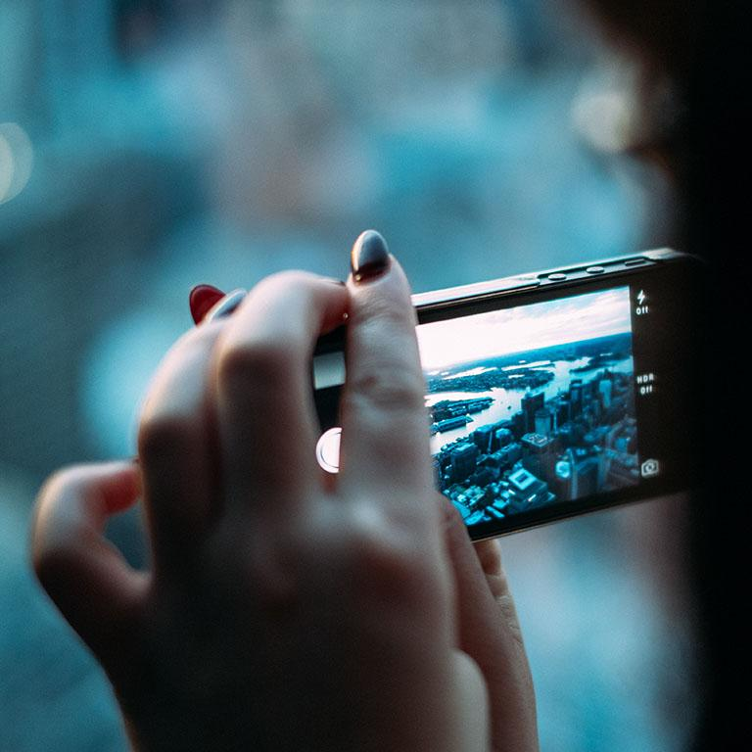
A PICTURE IS WORTH A THOUSAND WORDS
A complex idea can be conveyed with just a single still image.
Namely making it possible to absorb large amounts of data quickly.

Slide 15
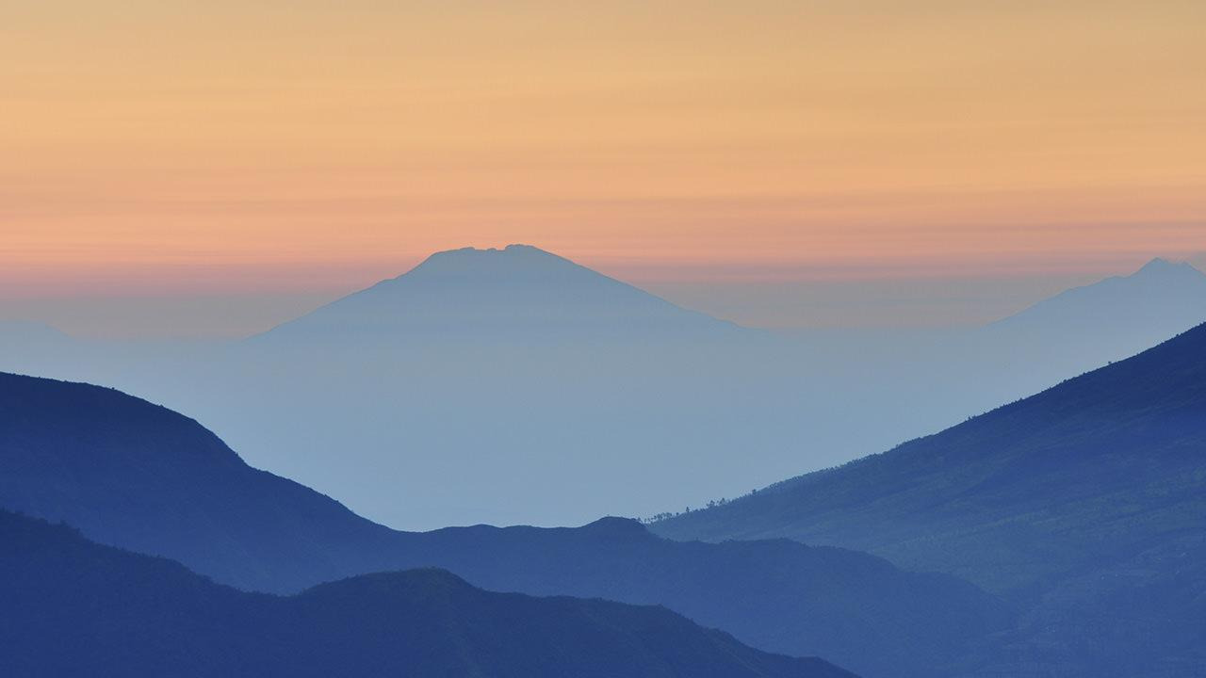
WANT BIG IMPACT?
USE BIG IMAGE.

Slide 16
USE CHARTS TO EXPLAIN YOUR IDEAS

Slide 17
AND TABLES TO COMPARE DATA
 | A | B | C
Yellow | 10 | 20 | 7
Blue | 30 | 15 | 10
Orange | 5 | 24 | 16

Slide 18
MAPS
our office

Slide 19
89,526,124
Whoa! That’s a big number, aren’t you proud?

Slide 20
89,526,124$
185,244 users
100%
That’s a lot of money
And a lot of users
Total success!

Slide 21
OUR PROCESS IS EASY
first
second
last

Slide 22
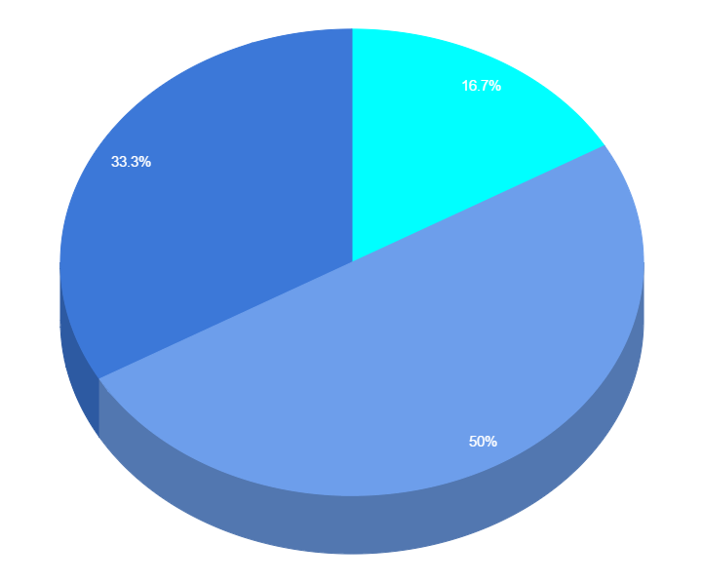
You can copy&paste graphs from Google Sheets

Slide 23
Place your screenshot here
ANDROID PROJECT
Show and explain your web, app or software projects using these gadget templates.

Slide 24
Place your screenshot here
iPHONE PROJECT
Show and explain your web, app or software projects using these gadget templates.

Slide 25
Place your screenshot here
TABLET PROJECT
Show and explain your web, app or software projects using these gadget templates.

Slide 26
Place your screenshot here
DESKTOP PROJECT
Show and explain your web, app or software projects using these gadget templates.

Slide 27
THANKS!
Any questions?
You can find me at
@username / user@mail.me

Slide 28
CREDITS
Special thanks to all the people who made and released these awesome resources for free:
Presentation template by SlidesCarnival
Photographs by Unsplash

Slide 29
PRESENTATION DESIGN
This presentation uses the following typographies and colors:
Titles: Oswald
Body copy: Source Sans Pro
You can download the fonts on this page:
https://www.fontsquirrel.com/fonts/oswald
https://www.fontsquirrel.com/fonts/source-sans-pro
Sky blue #00cef6 / Bright green #aff000 / Blue #3c78d8 / Dark blue #28324a
You don’t need to keep this slide in your presentation. It’s only here to serve you as a design guide if you need to create new slides or download the fonts to edit the presentation in PowerPoint®

Slide 30
SlidesCarnival icons are editable shapes.
This means that you can:
Resize them without losing quality.
Change fill color and opacity.
Change line color, width and style.
Isn’t that nice? :)
Examples:

Slide 31
😉
Now you can use any emoji as an icon!
And of course it resizes without losing quality and you can change the color.
How? Follow Google instructions https://twitter.com/googledocs/status/730087240156643328
✋👆👉👍👤👦👧👨👩👪💃🏃💑❤😂😉😋😒😭👶😸🐟🍒🍔💣📌📖🔨🎃🎈🎨🏈🏰🌏🔌🔑 and many more...

Slide 33

Free templates for all your presentation needs
For PowerPoint and Google Slides
100% free for personal or commercial use
Ready to use, professional and customizable
Blow your audience away with attractive visuals

